Slide 2
Introduction to Azure for web developers
Clemens Schotte
Technical Evangelist

Slide 3
Time | Min. | Session
10:00 – 10:05 | 5 | Welcome
10:05 – 10:30 | 25 | Session 1 - Microsoft Edge, a break from the past
10:30 – 11:15 | 45 | Session 2 - Innovations of the web
11:15 – 11:45 | 30 | Session 3 - Modern front-end tooling in Visual Studio
11:45 – 12:30 | 45 | HOL - Modern front-end tooling in Visual Studio (part 1)
12:30 – 13:30 | 60 | Lunch
13:30 – 14:00 | 30 | HOL - Modern front-end tooling in Visual Studio (part 2)
14:00 – 14:30 | 30 | Session 4 - Introduction to ASP.NET Core & Visual Studio Code
14:30 – 15:00 | 30 | HOL - Introduction to ASP.NET Core 1.0
15:00 – 15:15 | 15 | Break
15:15 – 16:00 | 45 | Session 5 - Introduction to Azure for web developers
16:00 – 16:50 | 50 | HOL - Getting started with Azure App Service Web Apps
16:50 – 17:00 | 10 | Conclusion

Slide 4
Why the cloud?

Slide 5
Why the cloud?
Rapidly setup environments to drive business priorities
Scale to meet peak demands
Increase daily activities, efficiency and reduced cost.
Speed
Scale
Economics

Slide 6
Load profiles
BATCH
PREDICTABLE
No
load
Load
Load
INCREASING
UNPREDICTABLE
Load
Load

Slide 7

28
Azure regions around the world
Hyper-scale footprint
Latest launch was in October 2015- India – Central, India – South, India – West
GENERALLY AVAILABLE
6 new regions announced: Canada Central, Canada East, Germany Central,
Germany North East, United Kingdom (2 – regions TBD)
More than AWS and Google Cloud combined
Azure regions

Slide 8
Hyper-scale
Azure
Enterprise proven
Hybrid

Slide 9
Hybrid
Hyper-scale
Enterprise proven
Hybrid
Hybrid
On-premises
Azure Stack

Slide 10


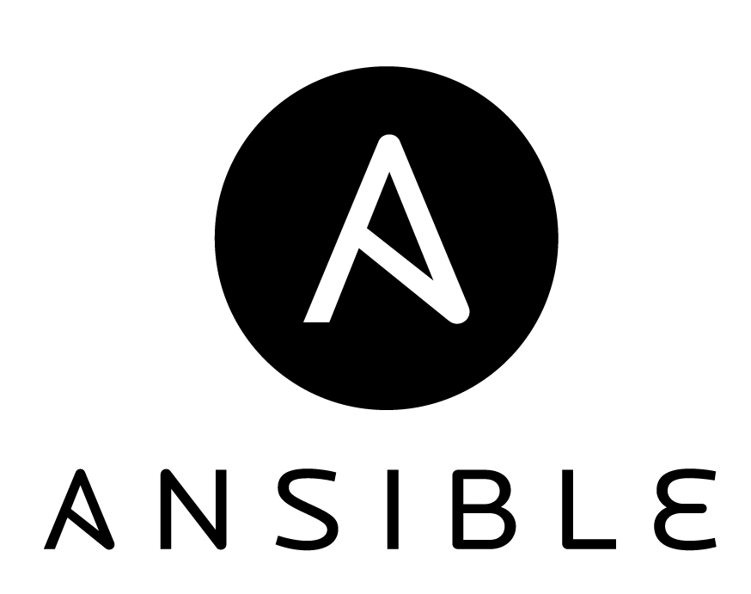


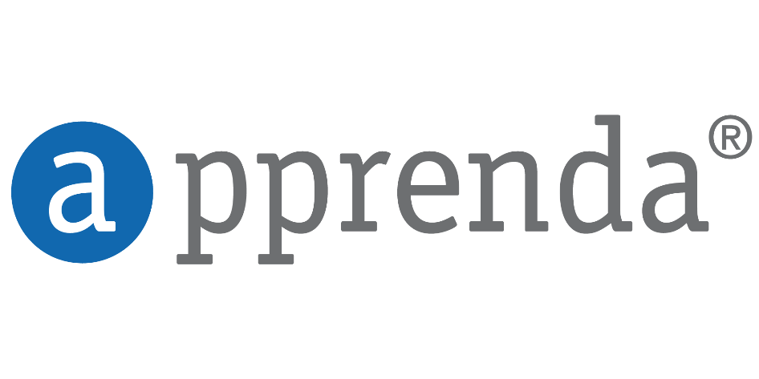















Open + Flexible
Management
Hyper-scale
Open & flexible
Applications
Enterprise proven
App Frameworks
Hybrid
Databases & Middleware
Infrastructure
Linux

Slide 11





Dev + IT productivity
Developer & IT productivity
Visual Studio
GitHub
Eclipse
Chef + Puppet
Powershell
Hyper-scale
Open & flexible
Enterprise proven
Hybrid

Slide 12

SaaS extensibility
Developer & IT productivity
Hyper-scale
Open & flexible
Enterprise proven
Hybrid
Platform for SaaS extensibility

Slide 13


























Trustworthy
More compliance certifications than any other cloud
Developer & IT productivity
Hyper-scale
Open & flexible
Enterprise proven
Trustworthy
Hybrid
Trustworthy
Platform for SaaS extensibility

Slide 14
Azure App Service

Slide 15


Azure App Service Build and scale great cloud apps
Web Apps
Mobile Apps
Logic Apps
API Apps

Slide 16
App Service - one integrated offering
Web Apps
Mobile Apps
Web apps that scale with your business
Build Mobile apps for any device
LOGIC Apps
API Apps
Automate business process across SaaS and on-premises
Easily build and consume APIs in the cloud

Slide 17
Develop apps with…
.NET | Node.js | PHP | Python | Java

Slide 18
Benefits of App Services
Automatic OS patching
Enterprise-grade security
High availability
Automated scale out/in
Built-in load balancing
Supports many languages and platforms
.NET, PHP, Node.js, Python, Ruby and many more
Easy continuous deployment
Continuous delivery from third-party source control providers
Built-in Git repo

Slide 19



Web Apps
Logic Apps
Mobile Apps
Administration App
Customer site
Order Completed
Customer App
http
SQL
API Apps

Slide 20
Web Apps

Slide 21
Full capability set available including:
.NET, Node.js, Java, PHP, and Python
WebJobs for long running tasks
Integrated VS publish, remote debug…
CI with GitHub, BitBucket, VSO
Auto-load balance, Autoscale, Geo DR
Virtual networking and hybrid connections
Site slots for staged deployments
Web Apps
Web apps run as-is
no changes required

Slide 22
App Service Web App
Web Site
Monaco
MSDeploy
Build/Upload Your Own
Kudu
Web Jobs
Gallery
Public Site Extensions
Private Site Extensions
Azure App Service Web App

Slide 23
Demo: Creating a Web App

Slide 24
WebJobs

Slide 25






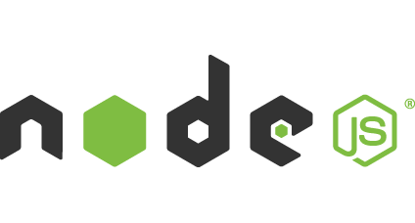

Light-weight CPU Intensive Tasks
run.cmd, run.bat
run.exe
run.ps1
run.sh
run.php
run.py
run.js
Job Type:
On-Demand, Scheduled, Continuous
Scale:
Singleton, Multi-instance
WebJobs SDK Feature:
BlobTrigger, TableTrigger, QueueTrigger, ServicebusTrigger
Deployment:
Portal, Visual Studio, CLI, Git

Slide 26

WebJobs
Web App

Slide 27
WebJobs
Web App

Slide 28
AutoScale

Slide 29
AutoScale
Web App

Slide 30
AutoScale
Web App

Slide 31
AutoScale
Web App

Slide 32
Application Insights

Slide 33
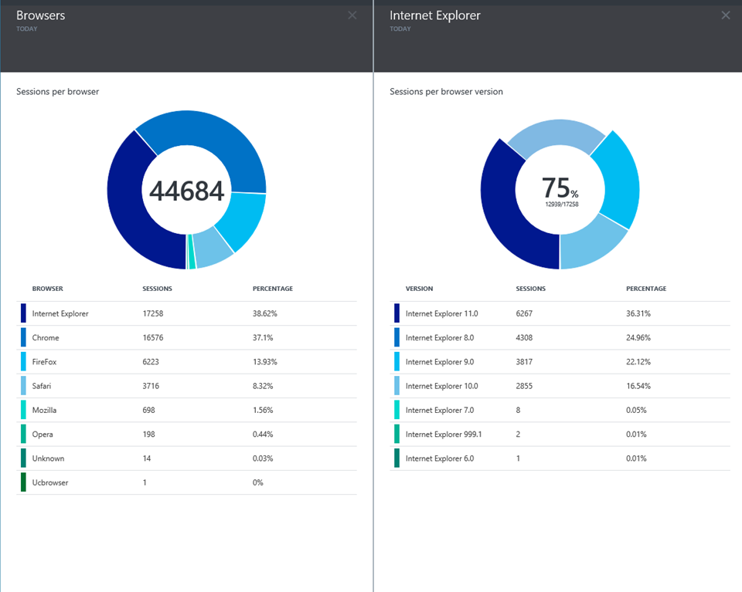
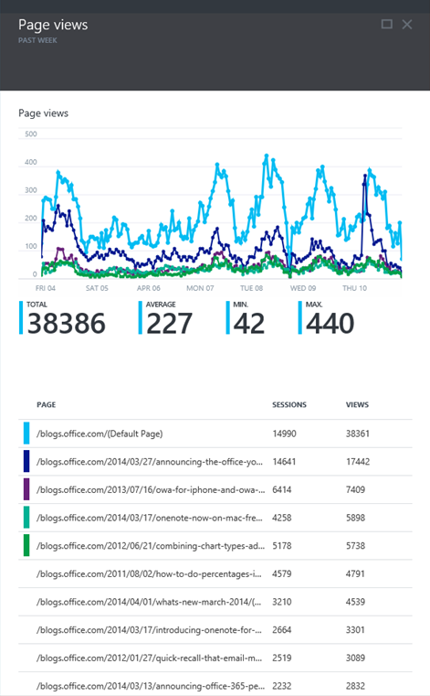
Application Insights
Application Insights

Slide 34



Get started
Visit azure.microsoft.com

